Slide 1
Colligative Properties: Boiling and Freezing Points
Section 5

Slide 2
Colligative Properties
Describe the characteristics of solutions
Depend on amount of solute ONLY
The effect is the same for all solutes

Slide 3
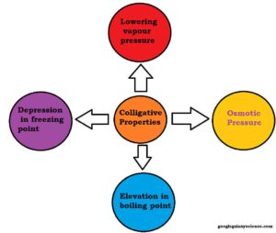

Slide 4
Boiling point elevation
REVIEW: Boiling point is the temperature at which a liquid changes to a gas
Adding a solute to a solvent will result in the boiling point INCREASING
Thus, the BP of a solution is ALWAYS HIGHER than that of the pure solvent
Ex: Water boils at 100°C. By adding salt to water, the BP will now be greater than 100°C

Slide 5
The formula
ΔT_{b} = i K_{b}  m
i → number of solute particles in formula
K_{b} → a constant that will be given to you
m →molality (mol/kg)
Solve for ΔT_{b} and then add it to the normal boiling point of the solvent which is told to you in the problem

Slide 6
LET’S TALK ABOUT i
REVIEW: Ionic compounds contain metals. Molecular compounds contain nonmetals only
If the solute is molecular, than i will equal one (1)
If the solute is ionic you have to count how many ions are inside the formula
Ex: NaCl has 2 ( 1 Na and 1 Cl). For this, i will equal 2.
Ex: Na2S has 3 (2 Na and 1 S). For this, i will equal 3.

Slide 7
Freezing point depression
REVIEW: Freezing point is the temperature at which a liquid changes to a solid
Adding a solute to a solvent will result in the freezing point DECREASING
Thus, the FP of a solution is ALWAYS LOWER than that of the pure solvent
Ex: Water freezes at 0°C. By adding salt to water, the FP will now be less than 0°C

Slide 8
The formula
ΔT_{f} = i K_{f}  m
i → number of solute particles in formula
K_{f} → a constant that will be given to you
m →molality (mol/kg)
Solve for ΔT_{f} and then subtract it from the normal freezing point of the solvent which is told to you in the problem

Slide 9
Example Problems
Water usually boils at 100 ° C. What is the new boiling point when 31.65 g of NaCl is added to 220.0 g of water? K_{b} water = 0.51 °C kg/mol
Water usually freezes at 0 ° C. What is the new freezing point when 400. g of ethylene glycol (C₂H₆O₂) is added to 500. g of water? K_{f} water = −1.86 ∘ C/m

